Slide 1


1
Batch No : 180426
Team Members
Taha Junaid [18BCD7072]
Mohd Taqiuddin [18BCN7050]
Darrain Saa-eyd[18BCN7009]
Shoaeb Nawab Shaik[18BEC7067]
P.Sai Teja[18MIS7109]
Chaitanya [18MIS7259]
Guided by
Prof.Asish Kumar Dalai Dept. of CSE
VIT-AP University, Amaravati

Slide 2
Agenda
Problem Definition
Circuit Diagram
Overall Flow Diagram
Module Implementation
Target Achievement
Time Line Chart
References
17-01-2019

Slide 3
Project Definition
The idea to make a blind person access all the benefits of his surroundings has lead us to work on this project. We aim to completely facilitate a visually impaired person in all sorts of possible ways.
31-03-2019

Slide 4
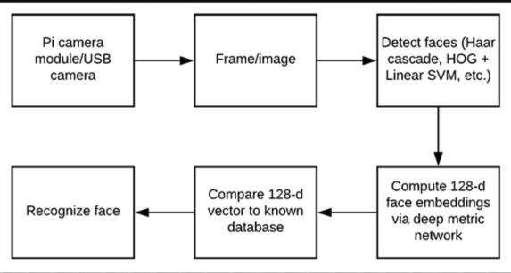
block DIAGRAM
31-03-2019

Slide 5
MODULE IMPLEMENTATION
Face recognition:In order to perform face recognition on the Raspberry Pi you first need to consider a few optimizations — otherwise, the face recognition pipeline would fall flat on its face.
Namely, when performing face recognition on the Raspberry Pi you should consider:
On which machine you are computing your face recognition embeddings for your training set (i.e., onboard the Raspberry Pi, on a laptop/desktop, on a machine with a GPU)
17-01-2019

Slide 6
The method you are using for face detection (Haar cascades, HOG + Linear SVM, or CNNs)
How you are polling for frames from your camera sensor (threaded vs. non-threaded)
All of these considerations and associated assumptions are critical when performing accurate face recognition on the Raspberry Pi .
31-03-2019

Slide 7
Before we can apply face recognition:
We first need to gather our dataset of example images we want to recognize.
Compute our face recognition embeddings.]
We will be using a deep neural network to compute a 128-d vector (i.e., a list of 128 floating point values) that will quantify e.ach face in the dataset.
VIT-AP University, Amaravati

Slide 8
GOOGLE ASSISTANT (AI)
Moreover, walking alone to unknown places has always been a scary task for them. But not now, as the AI installed in the module would give them walking directions to the nearest saloon or so.
This AI can even set alarms and reminders to get their daily chores done on time.

Slide 9
TARGET ACHIEVEMENT
Review 1- Requirement Identification , Designing the System.
Review 2- Module Implementation with face recognition. Review 3- completed Execution with google assistant.

Slide 10
FUTURESCOPE
Use Lithium Polymer battery to get a module which would be independent of the need for a wall socket for power supply.
Reader for the blind is yet to be added which would convert written text to speech output.
Use of specially designed boards instead of Arduino, since raspberry Pie gives faster response.

Slide 11
CONCLUSION
– The project as a whole was successful in developing a more durable navigation technique apart from the existing ones. The project, if used on a wider scale and Distributed to blind people , really has the ability to make to the community. The best part is that the cost of the parts doesn't exceed 2000rs thus making it affordable by everyone.
VIT-AP University, Amaravati
31-03-2019

